Slide 1
Embedded Linux Meets FPGA Capes – Just Imagine the DIY Possibilities!
By Andy Gikling – September 2013

Slide 2
Outline
BBot – My robot at Maker Faire
Robot needs, operating systems, micro-controllers
Linux Mini Computers
FPGAs
Integration examples
How you can get started

Slide 3
We live amazing Maker times
The internet has free knowledge about anything you could ever want to learn. Just look for it!
The Open Source movement is still in its infancy.
Things are changing very quickly.
People used to MAKE things – there was no other way – humanity needs more DIY attitude.
Thank you all for coming out to Maker Faire!

Slide 4
What is BBot?
An Open Source, drink-serving, remote controlled robot
The design is “free as in free beer”
It features a BeagleBone Black mini embedded Linux computer, coupled with Xilinx Spartan 6 FPGA cape called the “Mark1” by ValentF(x)

Slide 5
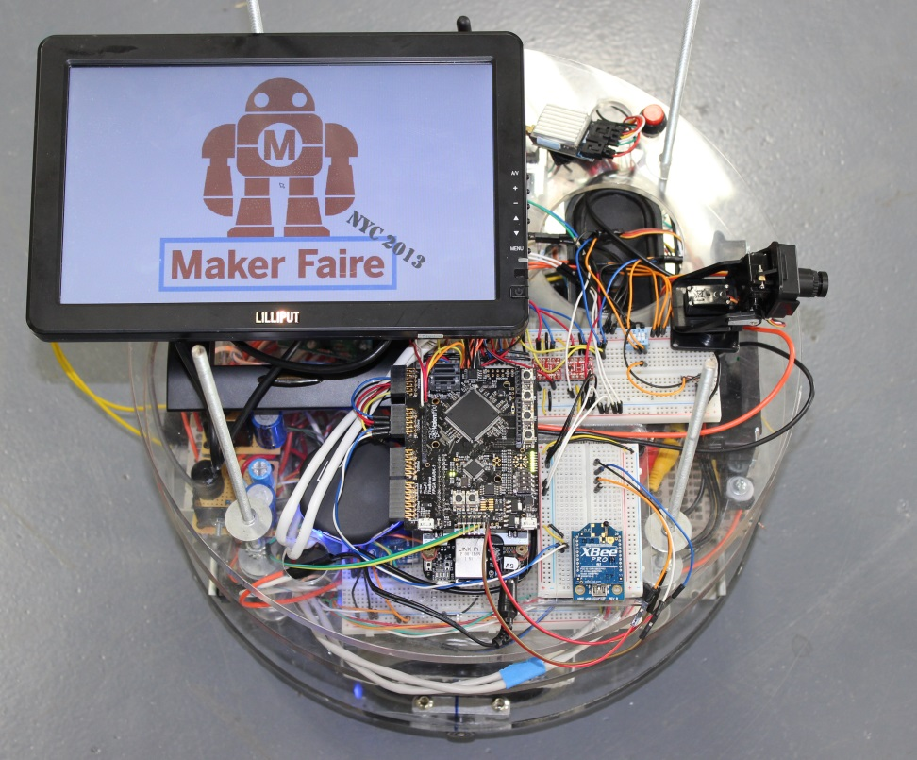
What motivated BBot?
Had to make up an idea for a Robot…
I LOVE LINUX
Wanted to learn more about software
Cheap hardware
Beverage serving robot seems appropriate and within reach

Slide 6
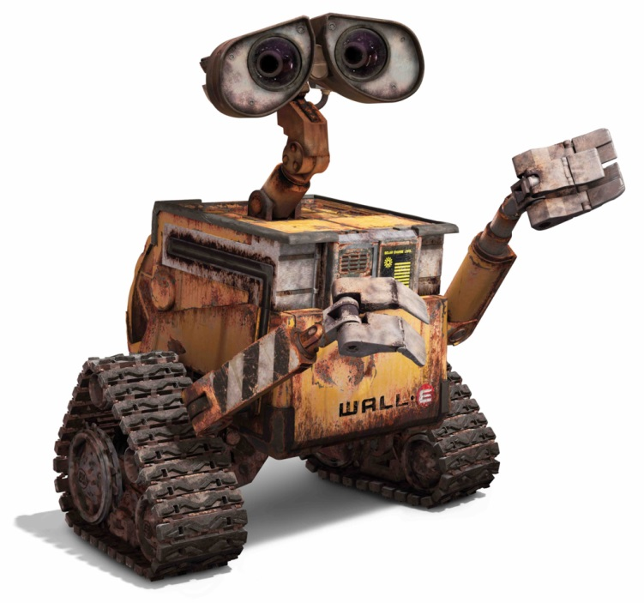
Common things robots need
Computation Power
Motion Control
Drives
Servos
Lots of I/O
Support for many electronics communication protocols
Low power consumption

Slide 7
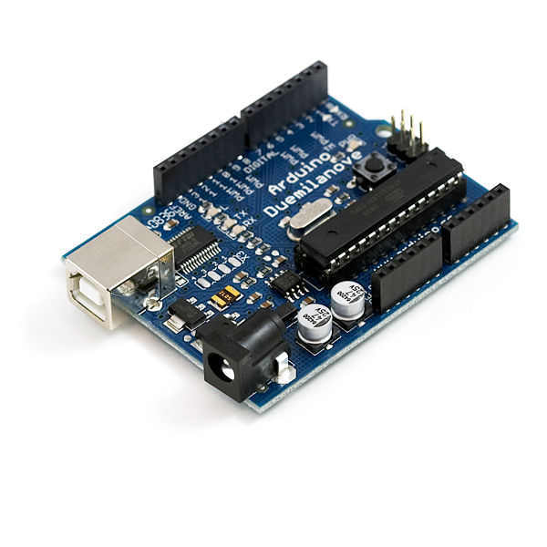
Limitations of micro-controllers
Limited computation abilities
Limited operating system support
In many cases – limited and basic I/Os
Very small storage capabilities and even smaller memory spaces

Slide 8
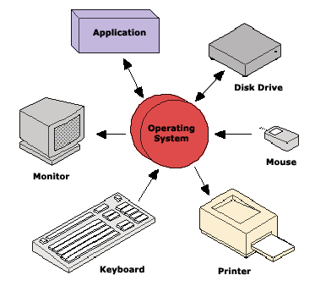
Why do I want an OS?
Break things down into logical blocks
Multitasking!
Threading
Example: Robot might need a program to run arms and a different program to run speech

Slide 9


So what is Linux?
The world’s premier Open Source operating system
Huge amount of free applications, drivers and documentation written for it
Industry proven
Server Farms
Embedded Electronics
The Desktop

Slide 10
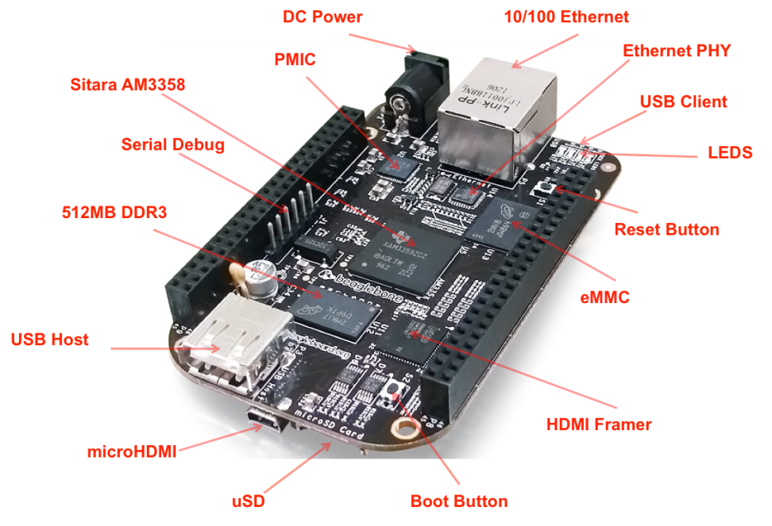
What is the BeagleBone Black?
Pure-Awesome!
A $45 Mini Linux Computer!
1GHz with 512MB DDR3 memory!
Nearly 90 IOs!
Angstrom Linux!
Other mini Linux computers:
Raspberry Pi
iMX6
ODroid

Slide 11
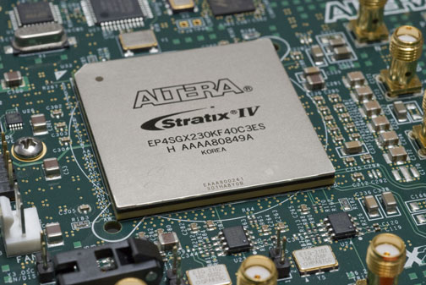
What is an FPGA?
Integrated circuit to create arbitrarily programmable digital circuits
It’s NOT a sequential processor like many people are used to

Slide 12
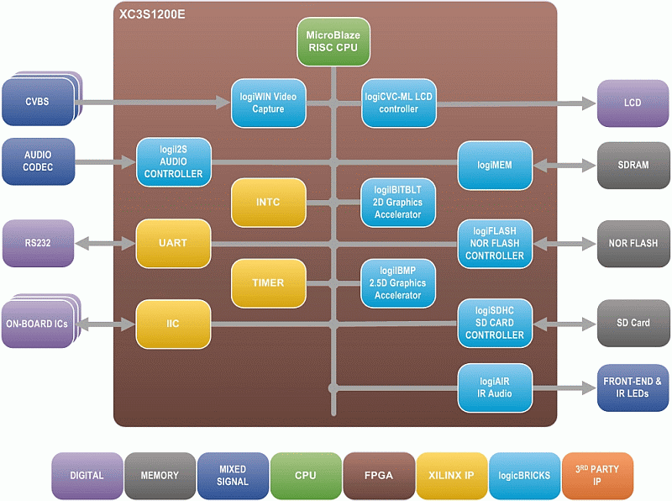
FPGAs provide many possibilities
You can add or remove blocks by simply reprogramming the chip!
Route I/O differently
Do computations in parallel
Use any system clock you want – time interfacing
Easier to interface HW

Slide 13
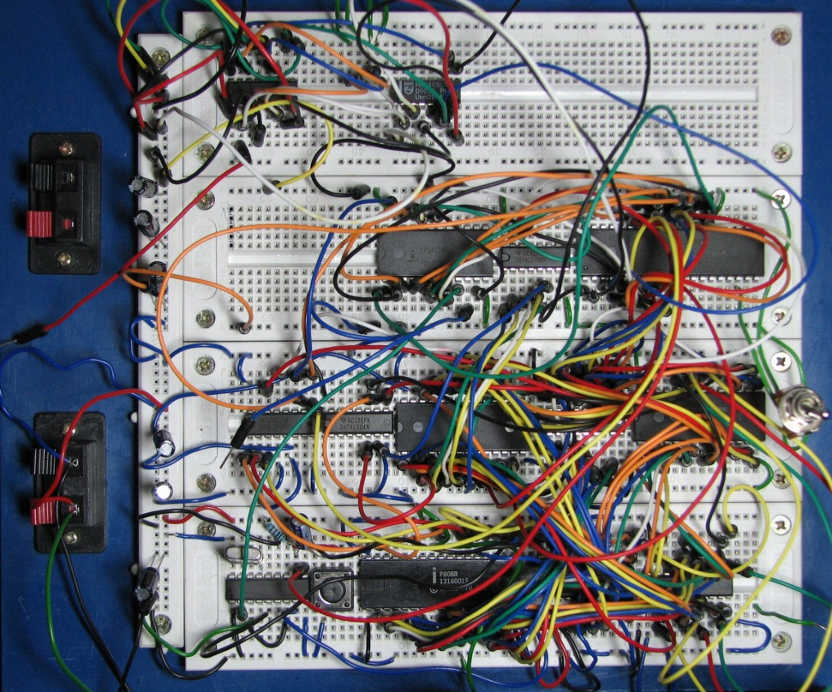
Other FPGA advantages
Ditch the breadboard full of discrete logic components!
Much easier to deal with bigger designs
Endlessly changeable
Better noise characteristics
Faster clocks

Slide 14
Mini Linux Computers + FPGAs = a perfect match
CPU runs application software – FPGA interfaces with hardware
Think – high level logic running as a Linux application and low level logic running on the FPGA
Can take your DIY project to the next level of sophistication very quickly

Slide 15
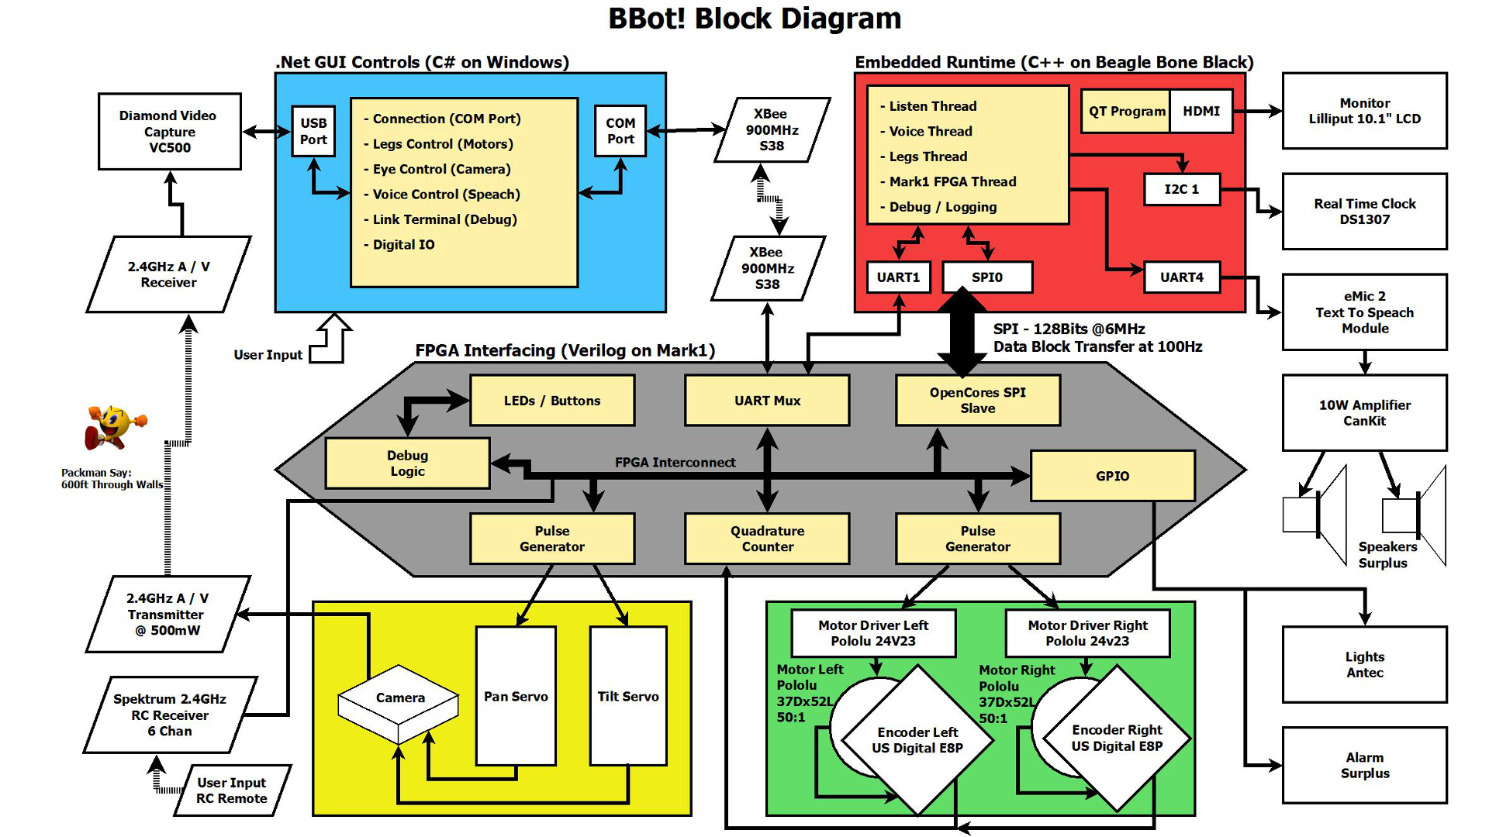

Slide 16
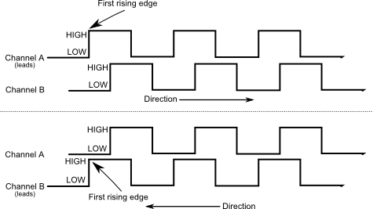
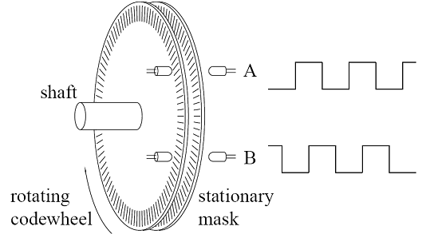
FPGA integration example 1 Digital Encoders
Each edge represents a count
Would be prohibitive to count edges with a micro controller’s interrupt lines or polling digital I/O…
Signal speeds in the KHz

Slide 17
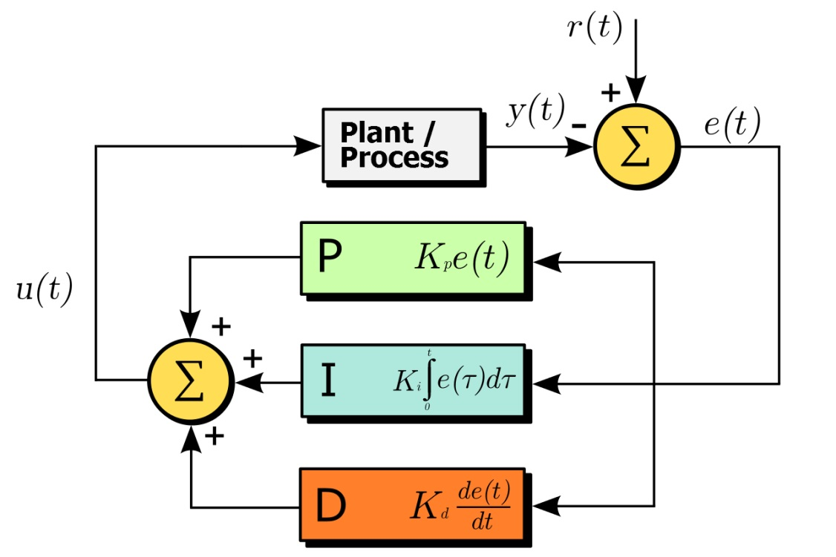
FPGA integration example 2 PID Controller
Microcontrollers are often used for PID control of motors and servos
OpenCores.com has an FPGA based PID controller

Slide 18
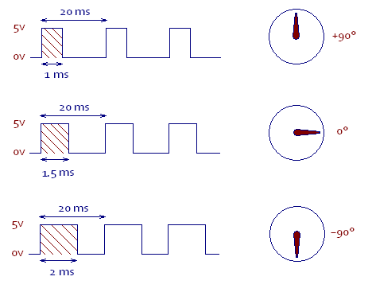
FPGA integration example 3 Digital Signal Generation
FPGAs can very easily generate digital signals
Hobby servo control signals are common pulse trains that are not easily simulated with discrete ICs

Slide 19
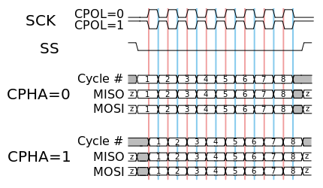
FPGA integration example 4 SPI Data Block Transfer
SPI can transfer data quickly in a surprisingly simple and effective manner
User defines protocol and data format
A data block transfer is perfect for motion control applications
FPGA registers can quickly be mapped to user application variables

Slide 20
Other integration possibilities
Open Hardware Vision
John Piat
“Internet Of Things” Smart Devices
Home automation
Security
Data Logging
Software Defined Radio
Anything needing “high speed digital interfaces”
SATA
PCIe
GPMC
AMBA

Slide 21
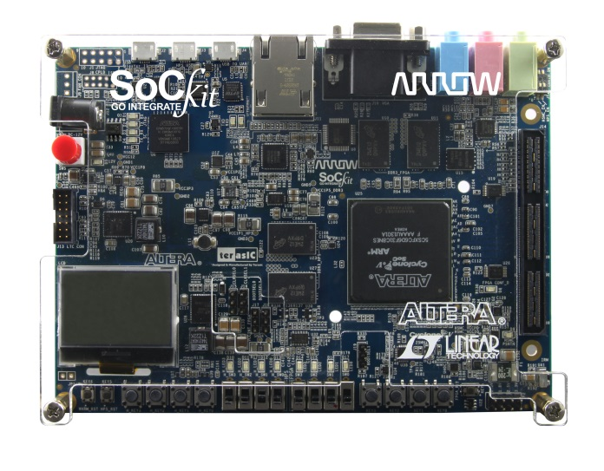
Where this technology is going
Total SoC solutions
Cell phones
All programmable hardware / software platforms
FPGA technologies and processors on the same chip

Slide 22
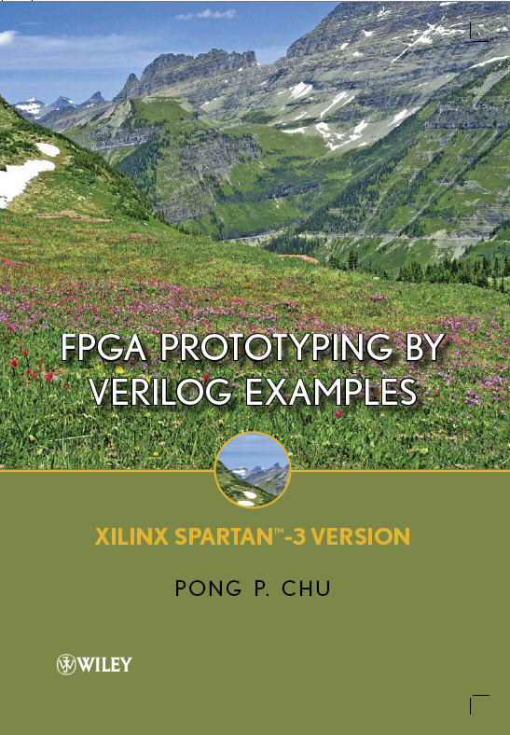
How to get started
Google “FPGA Tutorial!”
BBot’s source code and documentation is available at GitHub - Search: “BBot FPGA”
Buy an FPGA development kit
Look into the Raspberry Pi or the BeagleBone Black

Slide 23
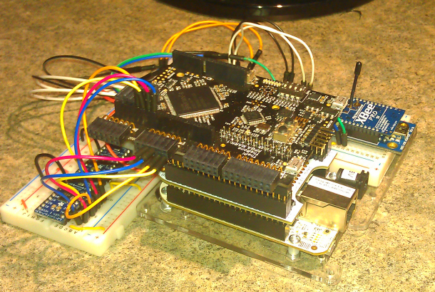
Valent Fx – Mark1
Mark1 will hopefully be available soon
Via Kickstarter or otherwise
Come talk with us at our booth if you’re interested

Slide 24
Conclusion
FPGAs and embedded Linux can take your DIY electronics project to the next level
Both topics have endless resources to learn from online!

